Slide 1
Conservation Easements
Matthias Nevins

Slide 2
AGENDA
Introduction
Land Trusts
Land Conservation tools
Conservation Easements
What are they? How do they work?
Components of Conservation Easements
Regional Examples: Conservation Easements in New England
Discussion
Notes:
Objective: introduce you to conservation easements. Give you some tools to read/interpret these documents

Slide 3
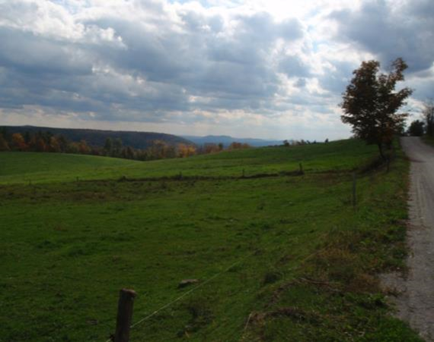
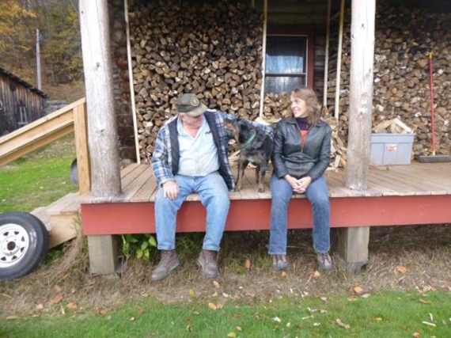
What is a land trust?
A non-profit charitable organization working with landowners to protect their land
-Hold legal interest in property to protect it

Slide 4
Land Protection Project
Landowner Goals
Natural Resources
Funding
LAND STEWARDSHIP
Notes:
The opportunity to use a CR comes about when the landowners goals are compatible with the resources on their land, and there’s a funding strategy that makes sense
CRs, like land, can also be sold or donated. A big question people usually have is about how these CRs are valued. The quick answer is that the land trust doesn’t’ come up with that figure. We always work with a qualified, independent appraiser who figures that out.
The appraiser figures out the value of the land with its full dev potential, and then figures out the value if that dev poten was removed. The difference between those two numbers is the price tag of the CR.

Slide 5
Landowner Goal: Keep the land as a farm or woodland forever
Do you want to continue
to own the land?
Yes
No
Donate/sell a Conservation
Easement (CE) to land trust
Donate or sell the land to land trust

Slide 6
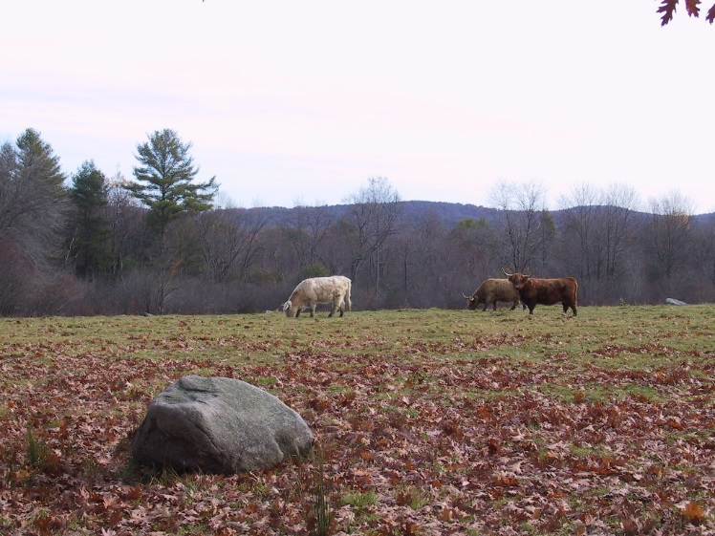
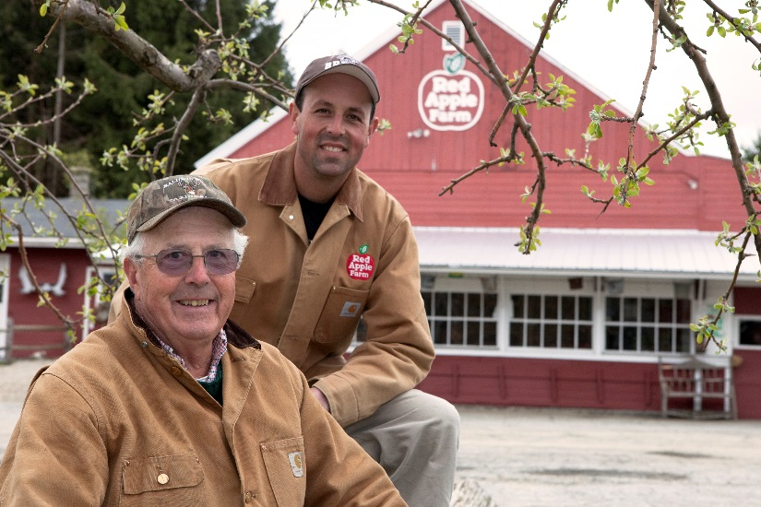
Conservation Easements (CE)
Legal agreement between a landowner and a land trust or public agency
Restricts the amount and type of development that can occur on the land.
Protects the property’s conservation values forever, in perpetuity – perpetual easement

Slide 7
Property Rights
Land Ownership
“bundle of rights”
Possession
-legal title
DEVELOP & SUBDIVIDE
Exclusion
-control access
Disposition:
-Sell
-Lease
Enjoyment
-use the land in any legal way

Slide 8
Landowner’s Property Rights with a CE
Land Ownership
“bundle of rights”
Possession
-legal title
Exclusion
-control access
Disposition:
-Sell
-Lease
Use Enjoyment
-use the land in any legal way
DEVELOP & Subdivide
LAND TRUST: Holds and protects certain rights to the land

Slide 9
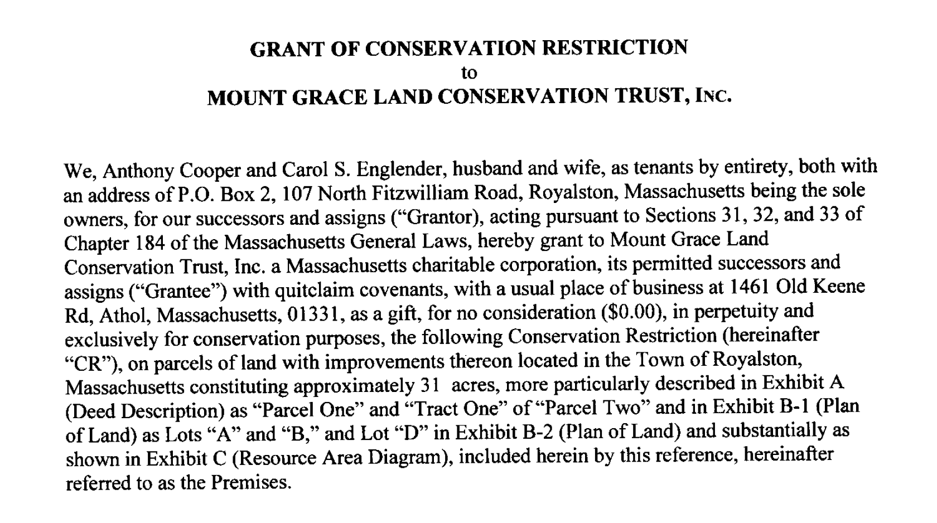
BASIC COMPONENTS OF CONSERVATION EASEMENTS
GRANT OF CONSERVATION EASEMENT
PURPOSES
PROHIBTED ACTS
RESERVED RIGHTS

Slide 10
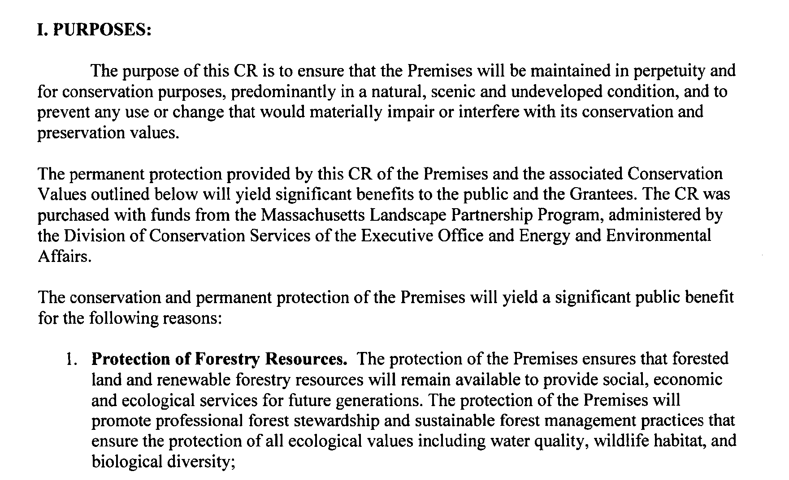
BASIC COMPONENTS OF CONSERVATION EASEMENTS
GRANT OF CONSERVATION EASEMENT
PURPOSES
PROHIBTED ACTS
RESERVED RIGHTS

Slide 11
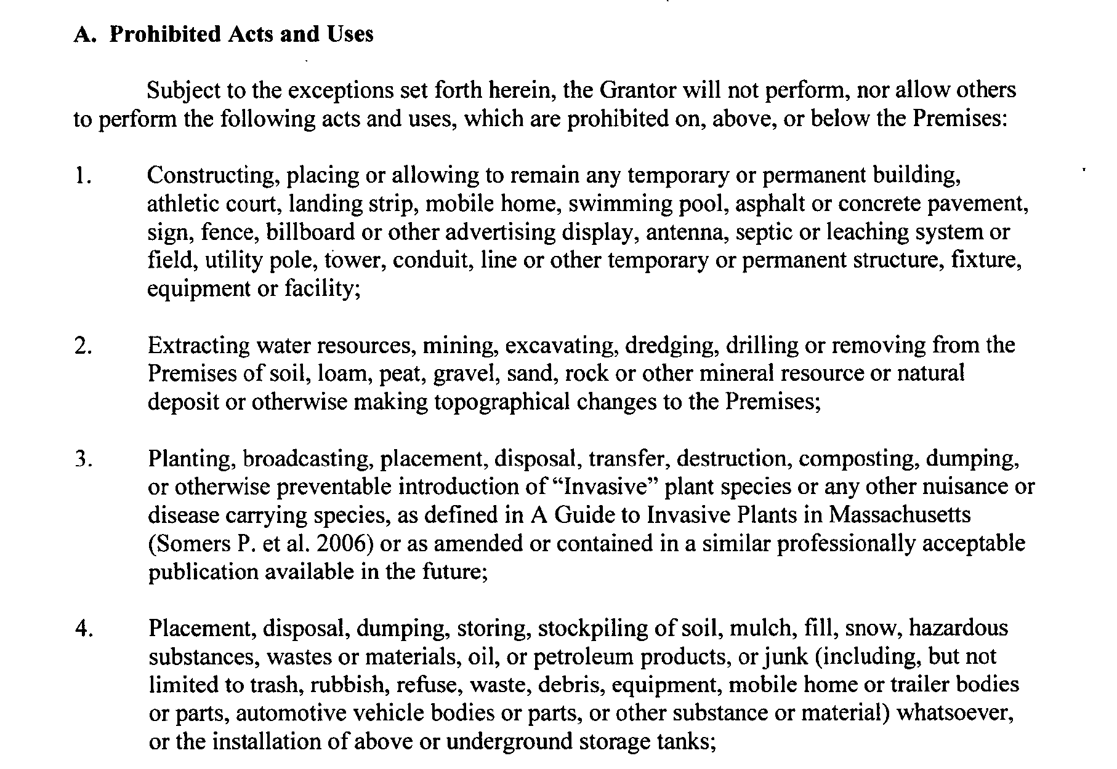
BASIC COMPONENTS OF CONSERVATION EASEMENTS
GRANT OF CONSERVATION EASEMENT
PURPOSES
PROHIBTED ACTS
RESERVED RIGHTS

Slide 12
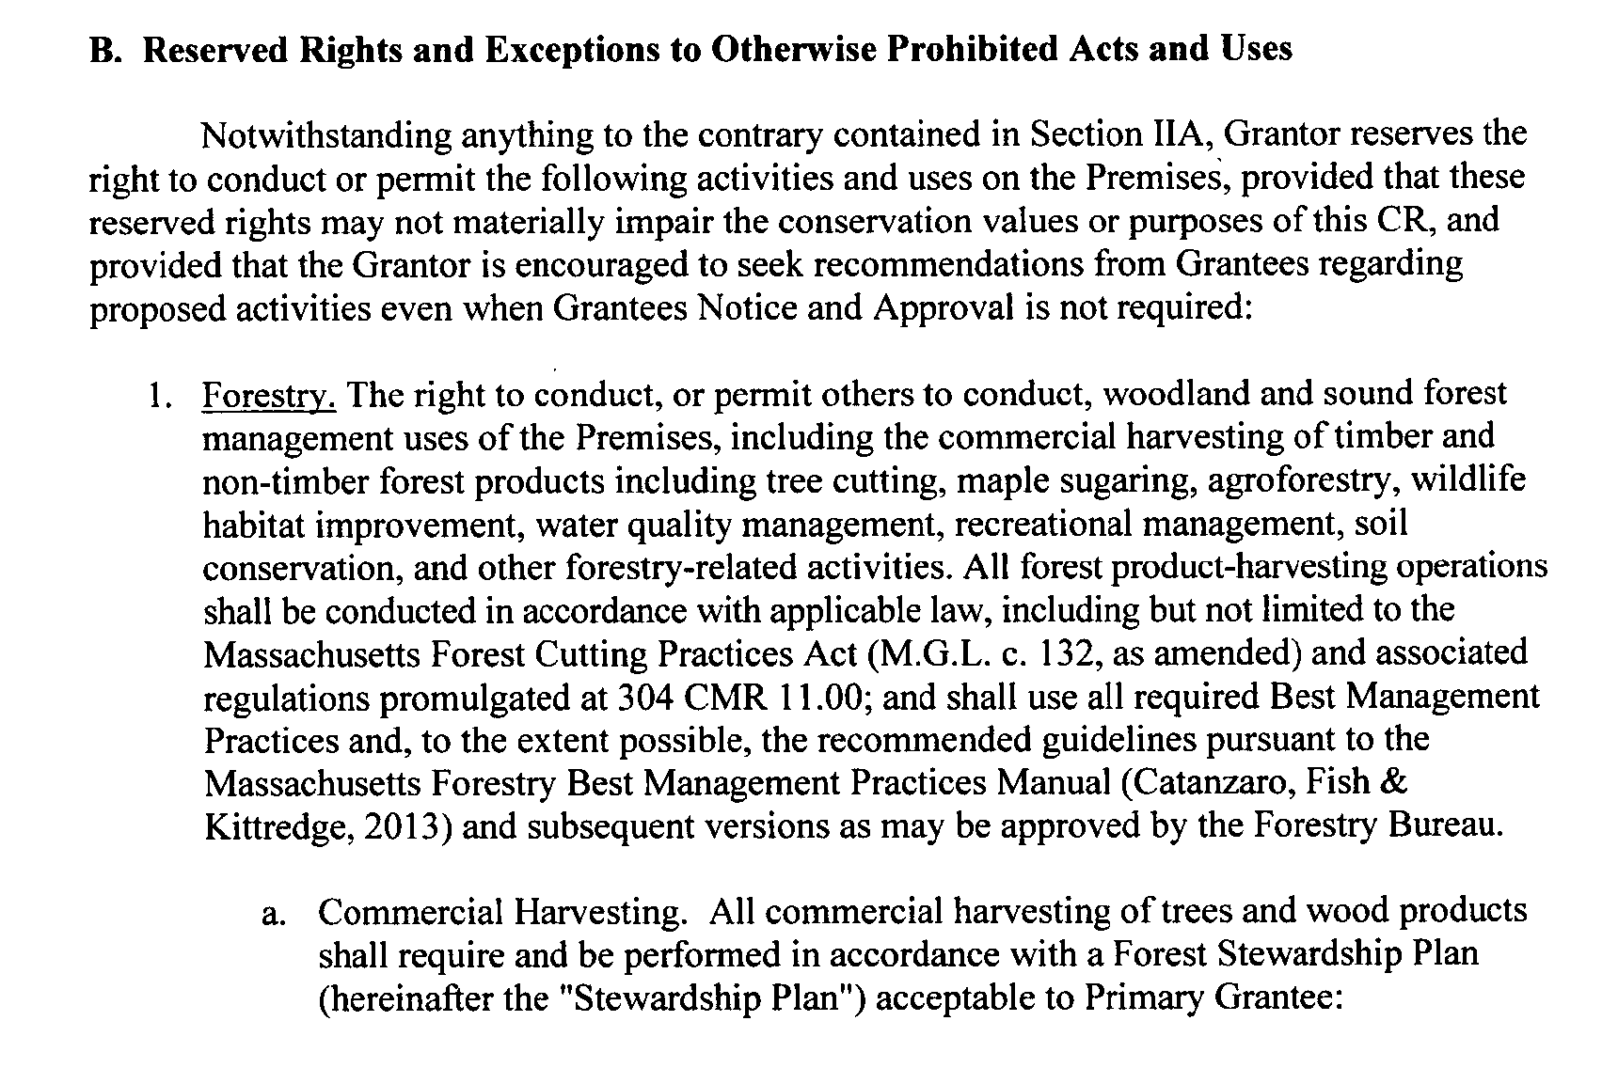
BASIC COMPONENTS OF CONSERVATION EASEMENTS
GRANT OF CONSERVATION EASEMENT
PURPOSES
PROHIBTED ACTS
RESERVED RIGHTS

Slide 13
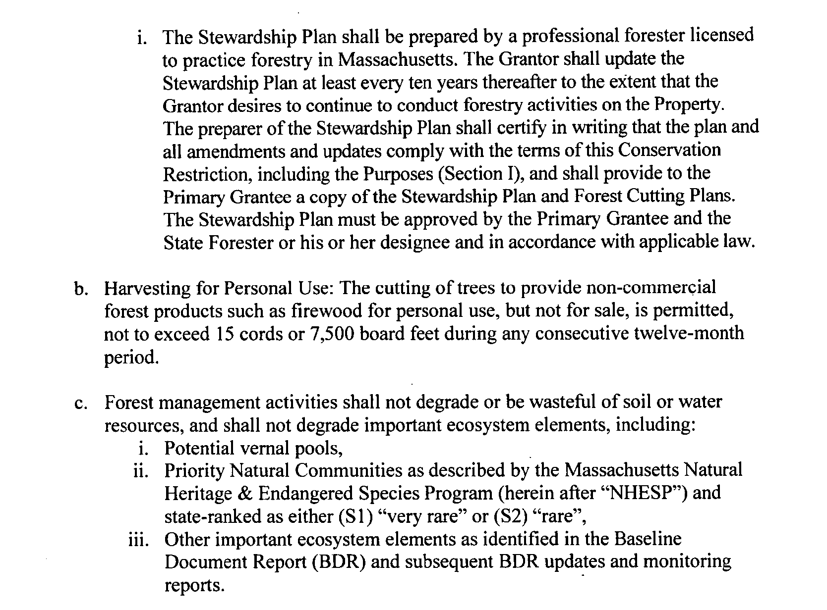
BASIC COMPONENTS OF CONSERVATION EASEMENTS
GRANT OF CONSERVATION EASEMENT
PURPOSES
PROHIBTED ACTS
RESERVED RIGHTS

Slide 14
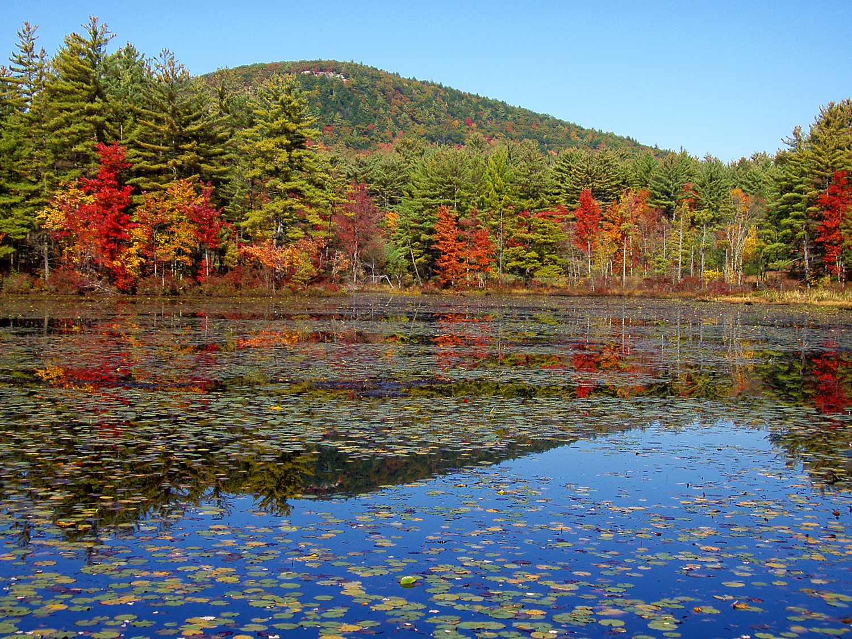
Regional Examples
Notes:
A bit about my background

Slide 15
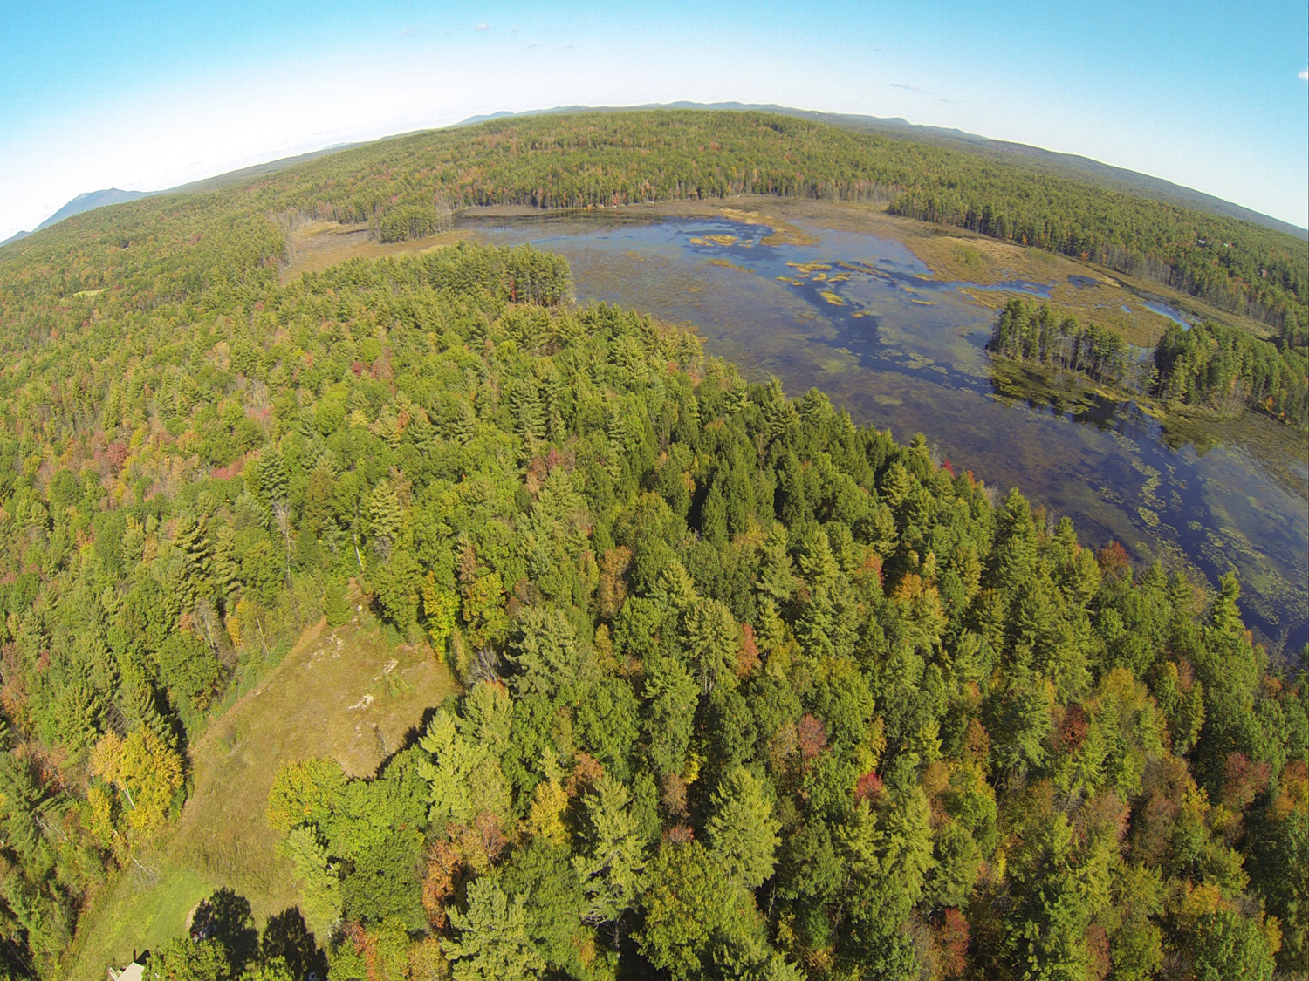
Discussion

